Slide 1



F
I
R
S
T
C
O
R
N
A
N
I
T
H
I
S
1
.
-
31
10
A free CD of this message will be available following the service
It will also be available for podcast later this week at calvaryokc.com

Slide 2
,
,
Woman without her man is nothing.
!
,
O
A
N
S
1.10-31
I
I
F
I
R
S
T
C
R
N
T
H

Slide 3

Fool!
O
A
N
S
1.10-31
I
I
F
I
R
S
T
C
R
N
T
H

Slide 4
Gal. 6.1 - Brethren, if a man is overtaken in any trespass, you who are spiritual restore such a one in a spirit of gentleness, considering yourself lest you also be tempted.
O
A
N
S
1.10-31
I
I
F
I
R
S
T
C
R
N
T
H

Slide 5
Gal. 5.16 - But if you bite and devour one another, beware lest you be consumed by one another!
O
A
N
S
1.10-31
I
I
F
I
R
S
T
C
R
N
T
H

Slide 6
Paul – Apostle to the gentiles
Apollos – educated sophisticates
cephas – traditional judiazers
cHrist – fundamental conservatives
O
A
N
S
1.10-31
I
I
F
I
R
S
T
C
R
N
T
H

Slide 7
C. H. Spurgeon – “I bless God that there are so many denominations. If there were not men who differed a little in their creeds, we should never get as much gospel as we do . . . God has sent different men to defend
O
A
N
S
1.10-31
I
I
F
I
R
S
T
C
R
N
T
H

Slide 8
different kinds of truth; but Christ defended and preached all . . . Christ's testimony was perfect.”
O
A
N
S
1.10-31
I
I
F
I
R
S
T
C
R
N
T
H

Slide 9
Acts 2:38 - … Repent, and let every one of you be baptized in the name of Jesus Christ for the remission of sins;
With a view towards
Because of
You need to reach for the brass ring
He Jumped for joy
O
A
N
S
1.10-31
I
I
F
I
R
S
T
C
R
N
T
H

Slide 10

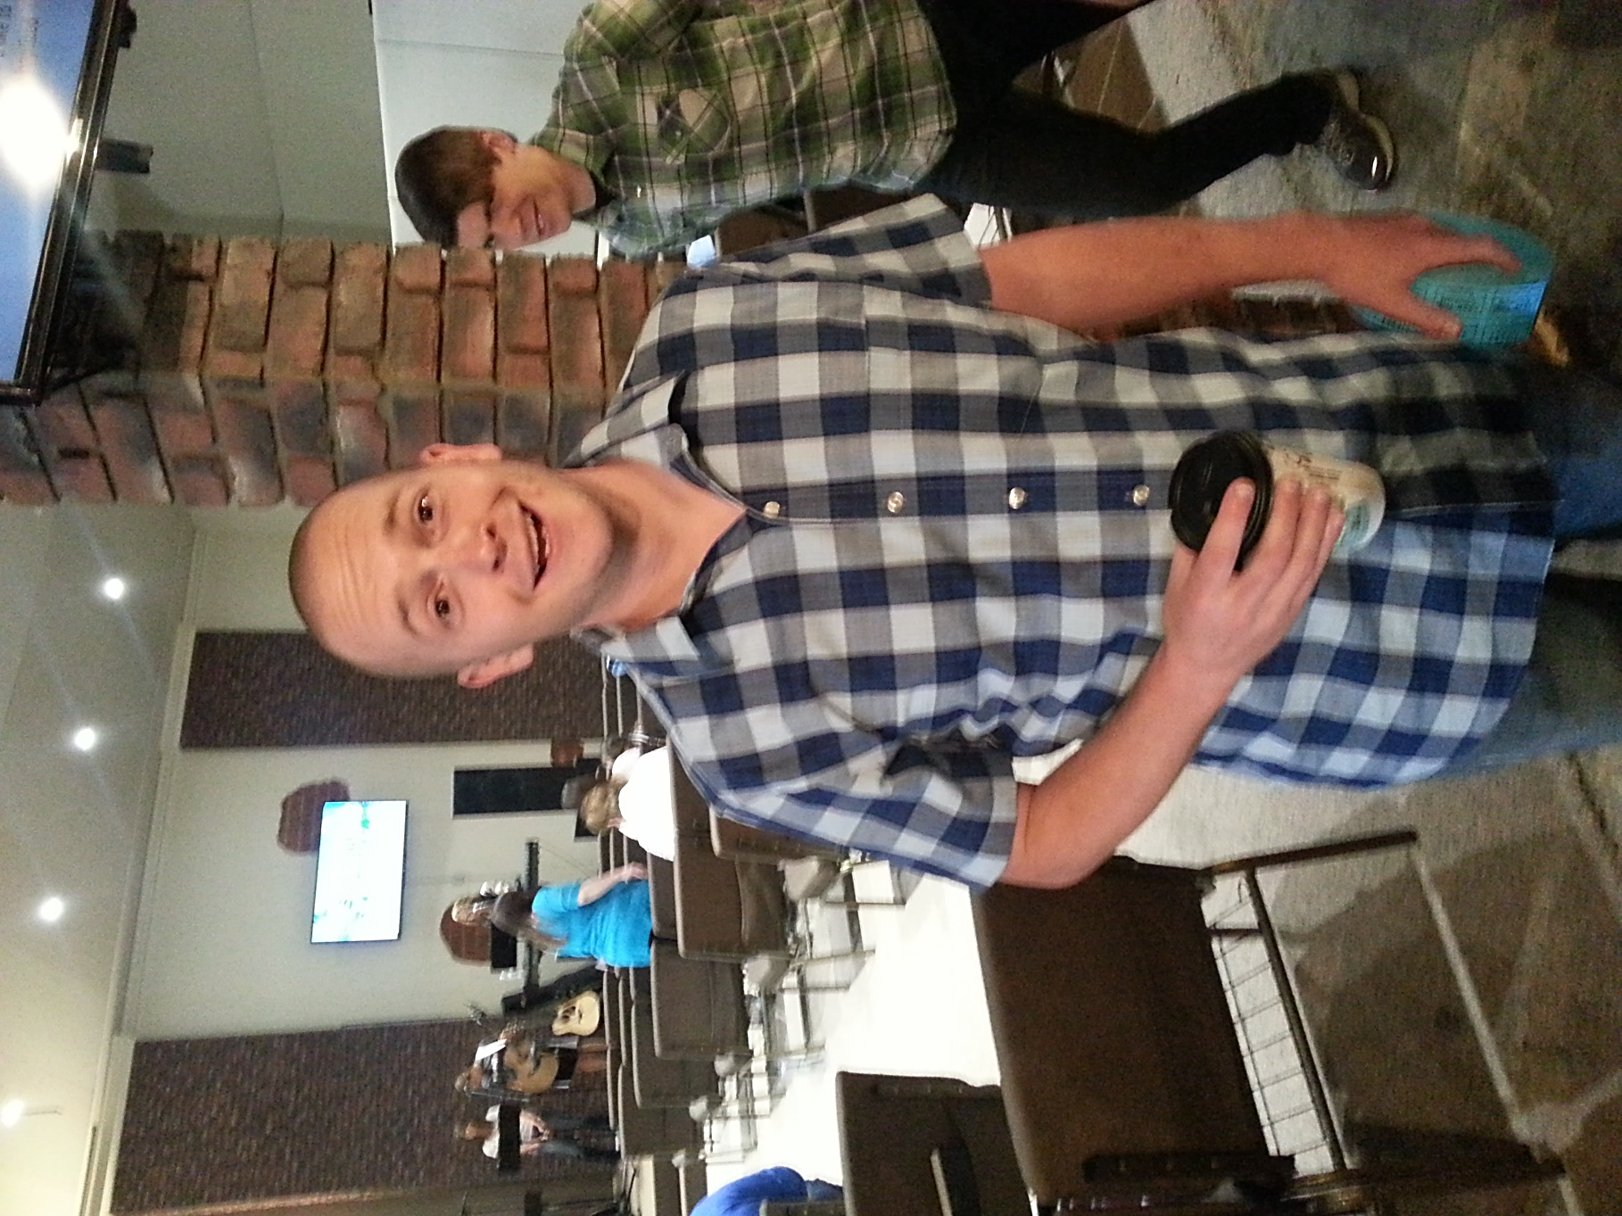
Wanted with a view towards bank robbery …
Wanted
Wanted because
of bank robbery …
For
Bank Robbery
Scott Whitacre
Dead or Alive
O
A
N
S
1.10-31
I
I
F
I
R
S
T
C
R
N
T
H

Slide 11
Luke 23.43 - … Assuredly, I say to you, today you will be with Me in Paradise.
O
A
N
S
1.10-31
I
I
F
I
R
S
T
C
R
N
T
H

Slide 12
Jew:
Religious:
Jesus is a stumbling block
Secularist:
Greek:
Jesus is foolishness
O
A
N
S
1.10-31
I
I
F
I
R
S
T
C
R
N
T
H

Slide 13
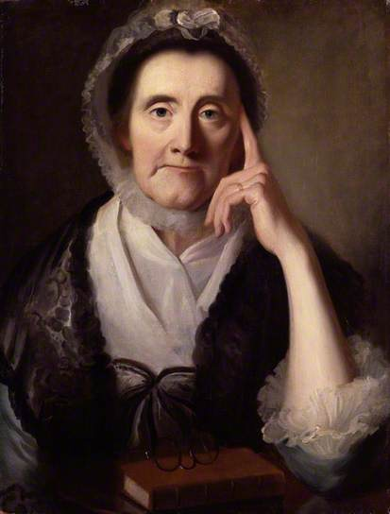
For you see your
calling, brethren,
that not
wise according
to the flesh, not
mighty,
not noble,
are called.
m
any
m
any
m
any
Selina Hastings, Countess of Huntingdon
O
A
N
S
1.10-31
I
I
F
I
R
S
T
C
R
N
T
H

Slide 14
Noble – eugenēs; well born
Base things – agenēs; not born
O
A
N
S
1.10-31
I
I
F
I
R
S
T
C
R
N
T
H

Slide 15
Winston Churchill –”Certain it is that while men are gathering knowledge and power with ever-increasing speed, their virtues and their wisdom have not shown any notable improvement as the centuries have rolled.
O
A
N
S
1.10-31
I
I
F
I
R
S
T
C
R
N
T
H

Slide 16
Under sufficient stress, starvation, terror, warlike passion, or even cold, intellectual frenzy, the modern man we know so well will do the most terrible deeds, and his modern woman will back him up.”
O
A
N
S
1.10-31
I
I
F
I
R
S
T
C
R
N
T
H

